Slide 1
SCH-MGMT 602: BIA Final Project Changes in AQI due to COVID Related Lockdowns in Indian Metros
By Shubham Shetty

Slide 2
Motivation
The COVID-19 pandemic of 2020 affected the entire world in an unprecedented manner. Global economy, industry, society, ecology etc. were all tremendously impacted.
An interesting positive impact of COVID related lockdowns was on air pollution. With production and traffic decreasing, it was expected that air pollution levels would also decrease.
India was one of the worst affected countries by the pandemic. India also has some of the worst cities by air quality in the world.
The Indian government announced a nationwide lockdown in late March 2020. Through my dashboard I aim to visualize the impact of the lockdown on air quality for some of India’s largest metropolitan cities.

Slide 3
Research Questions
How have COVID-19 related lockdowns affected AQI (Air Pollution) trends for 2 major metropolitan cities of India, namely Hyderabad and New Delhi?
What are the trends in AQI, and air pollutant concentration, over the last one year (post-COVID)?
Have cities with stricter lockdown measures seen more improvement in air quality levels than states with less strict measures?

Slide 4
Data File Description
Air quality data for past 5 years was gathered from following website - https://www.airnow.gov/international/us-embassies-and-consulates/
Data file dimensions –
1. Site
2. Date
3. Hour
4. AQI Category
5. Conc. Unit
Data file measures –
1. Air Quality Index (AQI)
2. NowCast Concentration
3. Raw Concentration

Slide 5
Data File Context
Air Quality Index – The U.S. AQI is EPA’s index for reporting air quality. Think of the AQI as a yardstick that runs from 0 to 500. The higher the AQI value, the greater the level of air pollution and the greater the health concern. For example, an AQI value of 50 or below represents good air quality, while an AQI value over 300 represents hazardous air quality.¹
NowCast Concentration - The NowCast gives you the latest information on air quality where you are. Because air quality can change during the day, you can expect to see the NowCast AQI change, too. ¹
¹ https://www.airnow.gov/aqi/aqi-basics/using-air-quality-index/

Slide 6
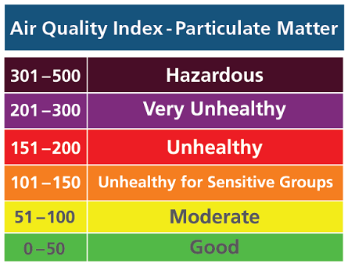
AQI Categories as defined by the US EPA -

Slide 7
Data Preparation
I scraped the data from the AirNow website using a Google AppScript code and loaded the data onto an Excel Sheet before uploading to Tableau. Find the script here - https://docs.google.com/spreadsheets/d/1ZWimaBdGtFzPG9fe_zlIGaMCf5uJTXAGr8msSEtGjTc/edit?usp=sharing
Data files are hosted here –
Hyderabad - https://docs.google.com/spreadsheets/d/1qKuF6-IX2or-Z7Zikbl2qR7oW1VifqVEMOrQvoLrHgE/edit?usp=sharing
New Delhi - https://docs.google.com/spreadsheets/d/1C0EvHzrE3ZhaRiq2A9btSrbTXkrmz3i172Pg1nJ6J8g/edit?usp=sharing

Slide 8
Visualizations
The project consists of 2 dashboards, 1 for New Delhi and 1 for Hyderabad. The following visualizations were used –
Bar Chart – Bar charts are used to compare discrete quantities. I’ve used bar chart to look at the number of days for each AQI category per year.
Line Graph – A line chart is used to visualize trends in data over intervals of time. In my project I’ve used a line chart to visualize monthly average AQI trends over multiple years.
Box & Whiskers Plot - A box and whisker plot—also called a box plot—displays the five-number summary of a set of data.
Dual Combination Graph – A combination of bar chart and line chart. I’ve used to visualize the relationship between AQI and NowCast Concentration.
Calendar (Custom Visualization) – I’ve created a calendar to visualize daily changes in avg. AQI across a month.

Slide 9
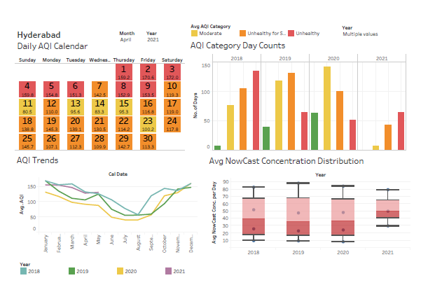
Dashboard 1 - Hyderabad

Slide 10
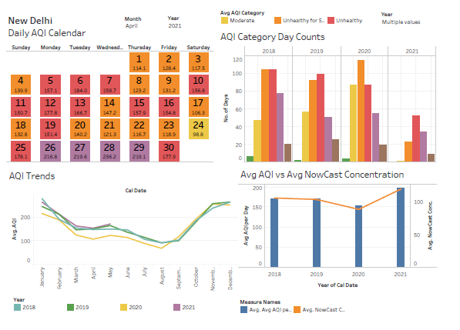
Dashboard 2 – New Delhi

Slide 11
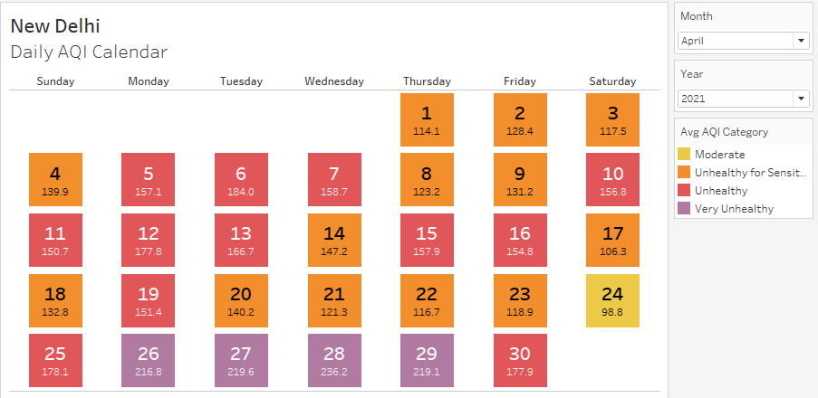
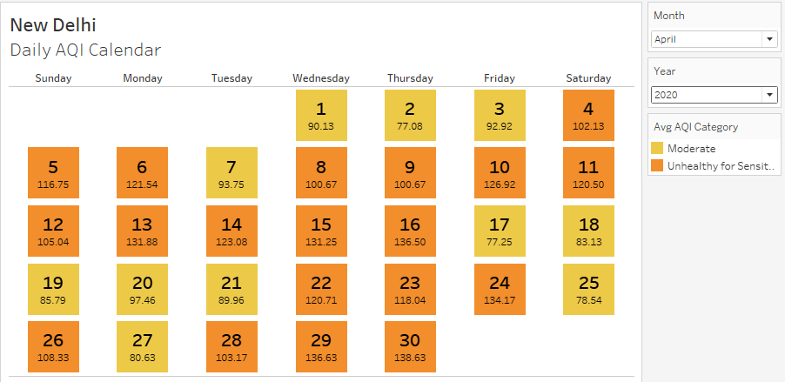
Custom Visualization – Daily AQI Calendar
The calendar shows daily AQI levels for a given month and year, with each day color coded according to the AQI category. This can be used to get a feeling of the AQI trends across a month, and over different years.
New Delhi – April 2021
New Delhi – April 2020
April 2020 was the month following nationwide lockdown implemented in India. From the calendar we can observe the
stark difference in AQI levels between April 2020 and April 2021 (no lockdown).

Slide 12
Lessons Learned - Hyderabad
From the line graph, it can be seen that Hyderabad had a significant dip in average AQI in the year as compared to previous years. However for 2021, that average has returned to the pre-pandemic levels.
From the bar graph, it can be seen that Hyderabad had a larger proportion of “Moderate” AQI days in 2021. Usually Hyderabad AQI category would be in the “Unhealthy” ranges.
From the box and whiskers graph, we can observe there is no considerable change in the median and min/max NowCast concentration levels for the year 2020 as compared to previous years.
From the calendar, we can see that in April 2020 Hyderabad had 19 moderate level days while in April 2021 the city had only 5 moderate level days, while having 8 Unhealthy level days.

Slide 13
Lessons Learned – New Delhi
From the line graph, it can be seen that New Delhi had a slight dip in average AQI in the year as compared to previous years, even though there was an uptick in the later part of the year. However for 2021, that average has returned to the pre-pandemic levels.
From the bar graph, it can be seen that New Delhi had a larger proportion of “Unhealthy for Sensitive Groups” AQI days in 2021. However, Delhi, being one of the most polluted cities in the world, usually has a larger proportion of “Unhealthy” and “Very Unhealthy” level days, which means this was an improvement.
From the dual combination graph, we can see that NowCast concentration and AQI are somewhat correlated. There was a slight dip in the NowCast Concentration in 2020, however this was followed by a significant jump in 2021.
From the calendar, we can see that in April 2020 New Delhi had 11 moderate level days and remaining “Unhealthy for Sensitive Groups”, while in April 2021 the city had only a single moderate level day, with 12 unhealthy days and 4 very unhealthy days.

Slide 14
Conclusion
From the observations from both case studies – New Delhi & Hyderabad – we can conclude that the lockdown did result in an immediate drop in air pollution levels.
However, these drops were only temporary, and with the lifting of lockdown restrictions, the pollution levels returned to their usual levels almost immediately.
Cities with strict lockdowns (Delhi) and slightly less strict restrictions (Hyderabad) both had similar trends in AQI levels.
It can be concluded that the drops in air pollution were only a temporary phenomenon caused due to halting of production during lockdown, and that COVID has not had a long-term positive impact on the environment.

Slide 15
Appendix
1. Tableau Source File –
2. Hyderabad Data Extract –
3. New Delhi Data Extract –

